Slide 1
Title here. Font size 44pt, Univers Condensed, BOLD
N. Surname, N. Surname (16pt, Univers Condensed Light, ITALIC)
mail@mail.com (corresponding author’s mail)
Affiliation
Location

Slide 2
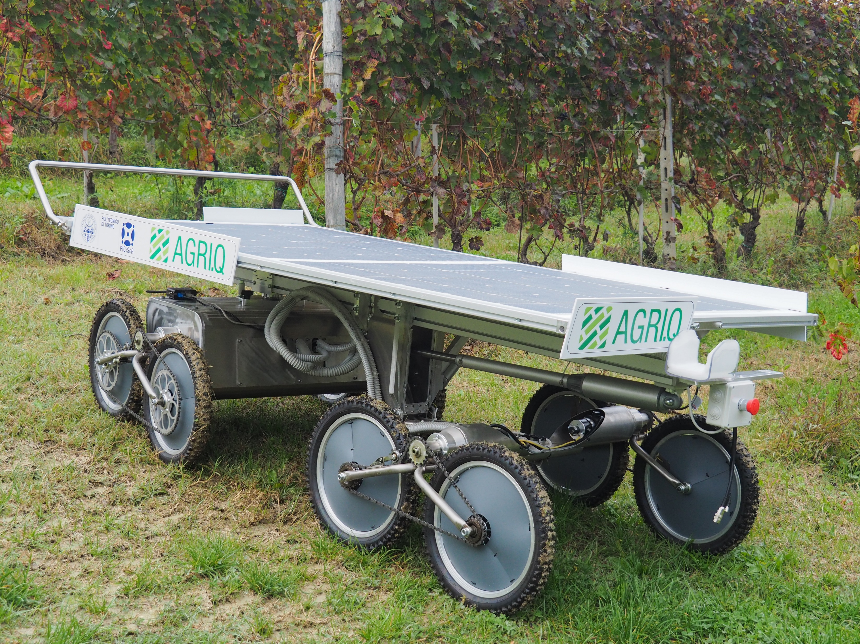
Title page EXAMPLE
A. Botta, P. Cavallone, L. Tagliavini, L. Carbonari, G. Quaglia
andrea.botta@polito.it
DIMEAS, Politecnico di Torino
Turin, ITALY

Slide 3
HOW TO PLACE SDGs CORRECTLY IN THE TITLE SLIDE
Select the desired SDGs (use shift+click or ctrl+click to select multiple ones). They are already in with the right size (30x30mm). Select also the spacer rectangle (25x0.2mm)
Copy them into the title slide
Place them within the placeholder in the right order
Align all the icons along the placeholder horizontal centre line. (select the placeholder first, then the icons, and then use the tool “Arrange > Align > Align Middle)
Use the spacer to space correctly the icons
Delete the spacer
Select all the icons and group them together (use shift+click or ctrl+click to select multiple ones, then right click > Group > Group).
Align the group of icons with the placeholder vertical centre line. (select the placeholder first, then the group, and then use the tool “Arrange > Align > Align Center)
Remove the placeholder
COPY THIS SPACER

Slide 4
Section title
Use the following Section titles
Research Goals
Methods
Discussion
Conclusion
Essential References
The maximum number of slides is 8
For your headings use Univers Condensed, size 24. Use a white colour text or the colour used here.
For your main text use Univers Condensed Light, size 18. Use a white colour or the colour used here.
This template has already some suggested layouts (right click on the slide to change). You can use custom layout as long as your slides are similar to the proposed ones.

Slide 10
Essential References
Use this section to list only some essential publications.
Use Univers Condensed Light with font size of 16pt
[Author Last Name], [Author First/Middle Name Initial(s)]. ([Publication Year]) ‘[Title of the article]’, [Name of the Journal], [Volume Number], ([Issue Number]), pp. [Page number starts]-[ends]. [Digital Object Identifier] or Available at: [URL] (Accessed: [Access Date]).

